Slide 1
Plant Disease Detection (using AI)
Team MediVine

Slide 2
Contents
Idea
Technology
Scope and apps
Conclusion

Slide 3
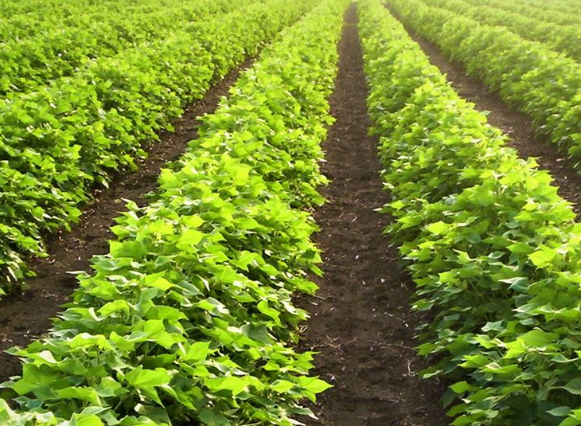
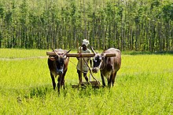
Idea
SmartFarming AgroTech
AI

Slide 4
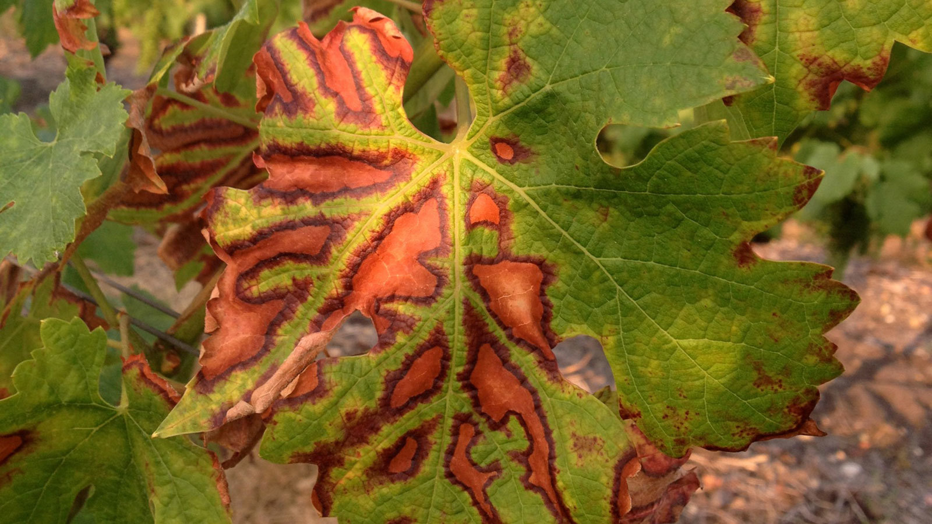
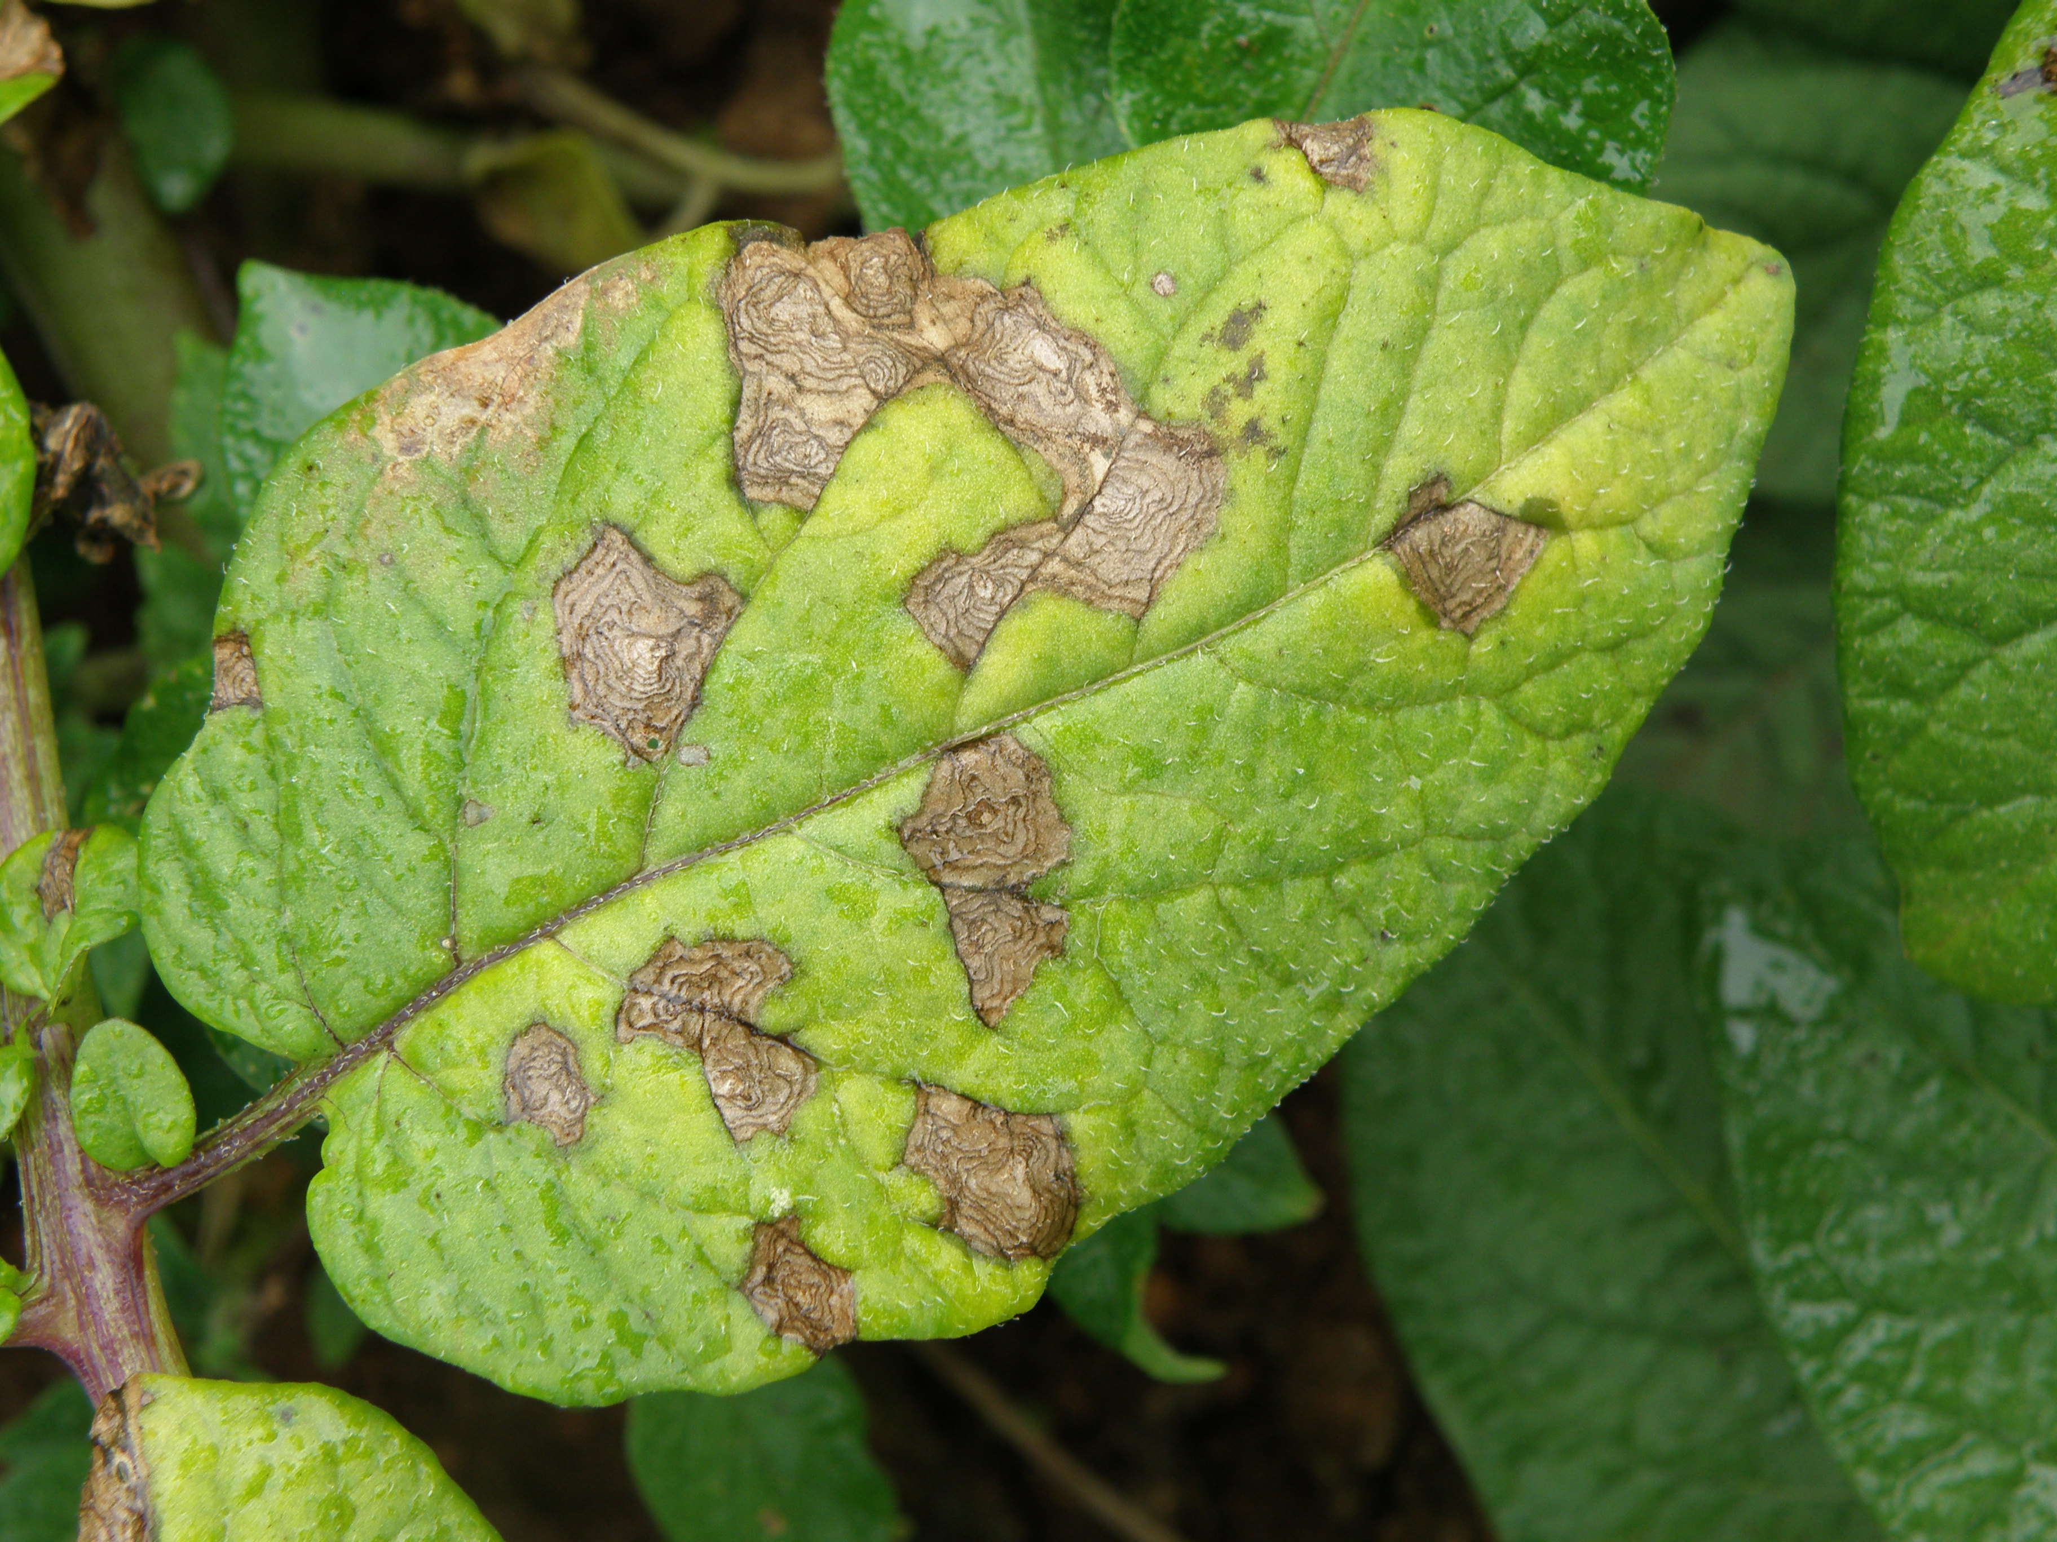
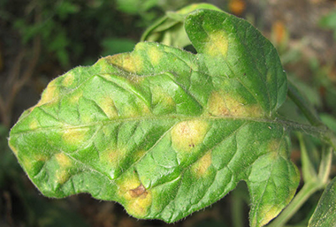
Esca, Grape
Blight, Potato
Mold, Tomato

Slide 5

Technology
State of the Art AI library
Keras wrapper
CNN for images

Slide 6

Python server framework
REST API
Compatible with TensorFlow

Slide 7

Non structures
Scalable database
???

Slide 8

Containerization
High availability
Clustering

Slide 9
Scope and Applications
Realtime image detection
Diagnosis and cure information
Expert support
Tailor made for Farmers

Slide 10
Conclusion
Innovation for Agriculture
A step towards enabling rural farmers
Growth of the agriculture economy

